Slide 1
Introduction to GitHub Actions

Slide 2
How do I write my own Custom Action?
How did we do CI/CD for GitHub?
What are GitHub Actions?

Slide 3





How did we do CI/CD for GitHub?
Notes:
We used an external system

Slide 4
What are GitHub Actions?

Slide 5
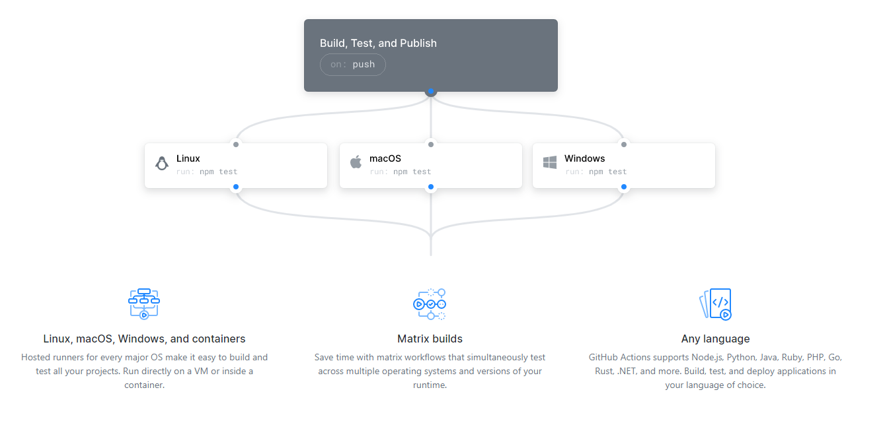
Run a workflow on any GitHub event
Notes:
A means to do CI/CD inside the GitHub experience.
For those familiar with Azure DevOps pipeline you will see known concepts, but this is all new language and action wise
Linux, macOS, Windows, and containers
Matrix builds
Any language

Slide 6
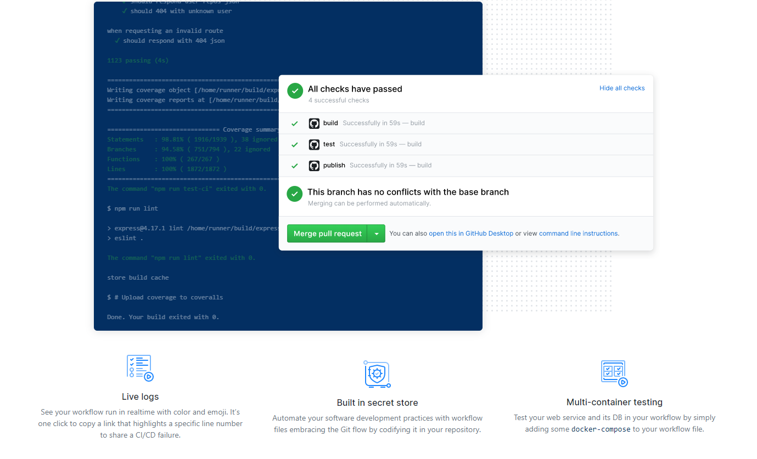
Built to Scale
Notes:
Live Logs
Built in secret store
Multi-container testing

Slide 7
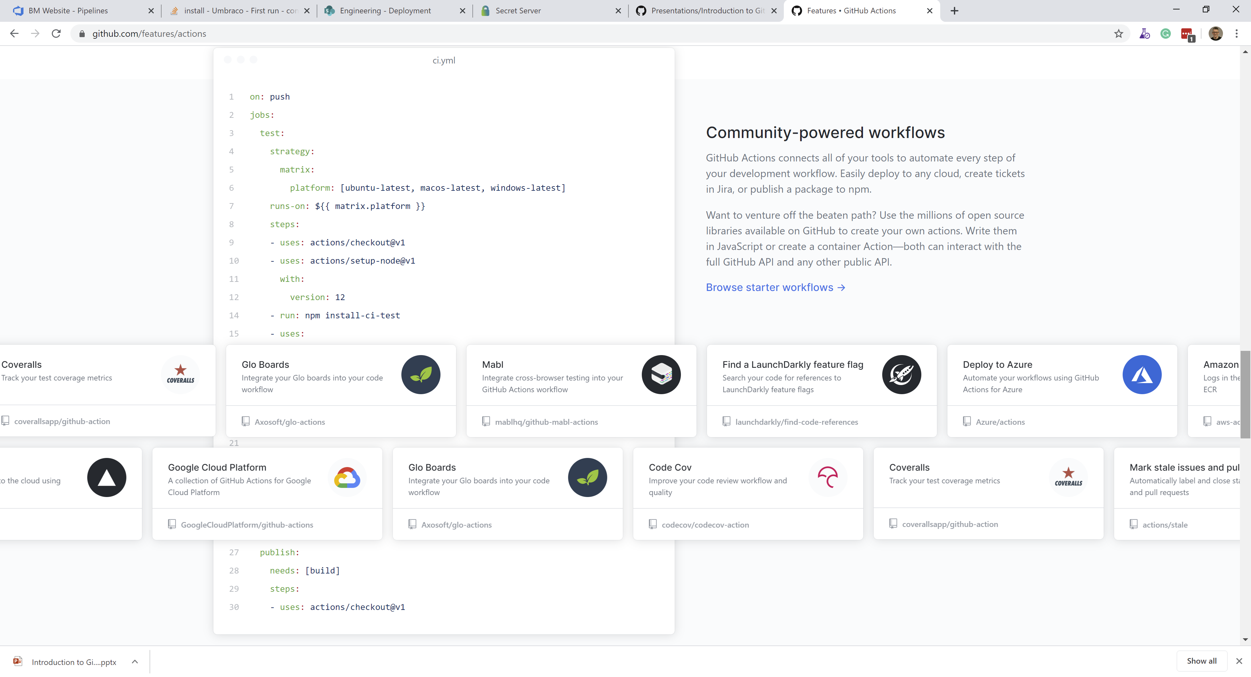
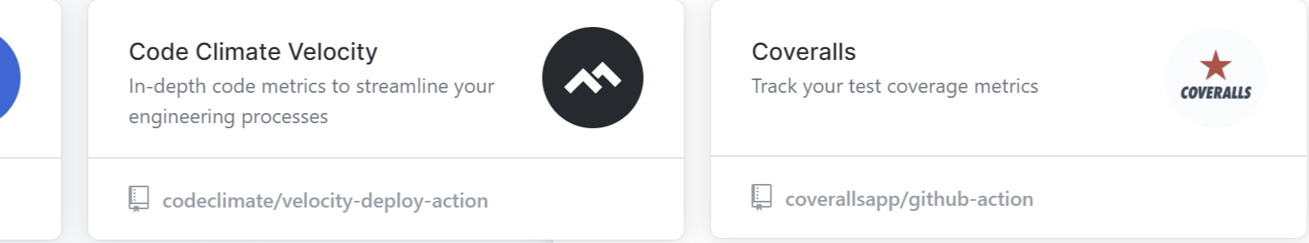
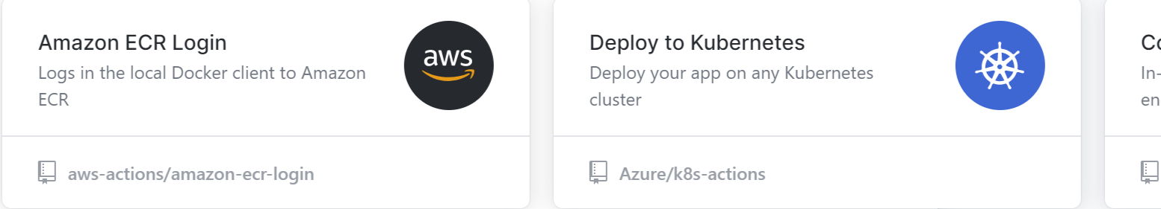

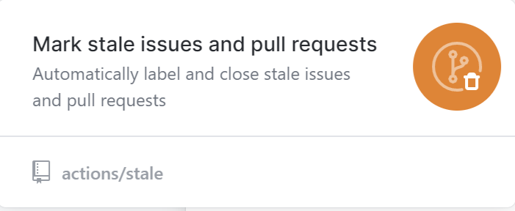
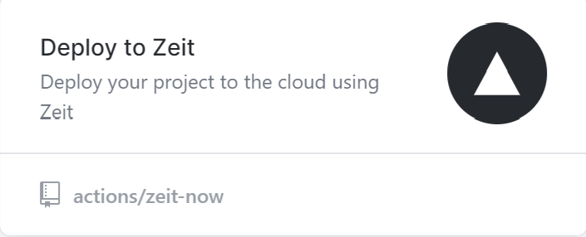
Community-powered workflows
Notes:
Community-powered workflows
GitHub Actions connects all of your tools to automate every step of your development workflow. Easily deploy to any cloud, create tickets in Jira, or publish a package to npm.
Want to venture off the beaten path? Use the millions of open source libraries available on GitHub to create your own actions. Write them in JavaScript or create a container Action—both can interact with the full GitHub API and any other public API.

Slide 8
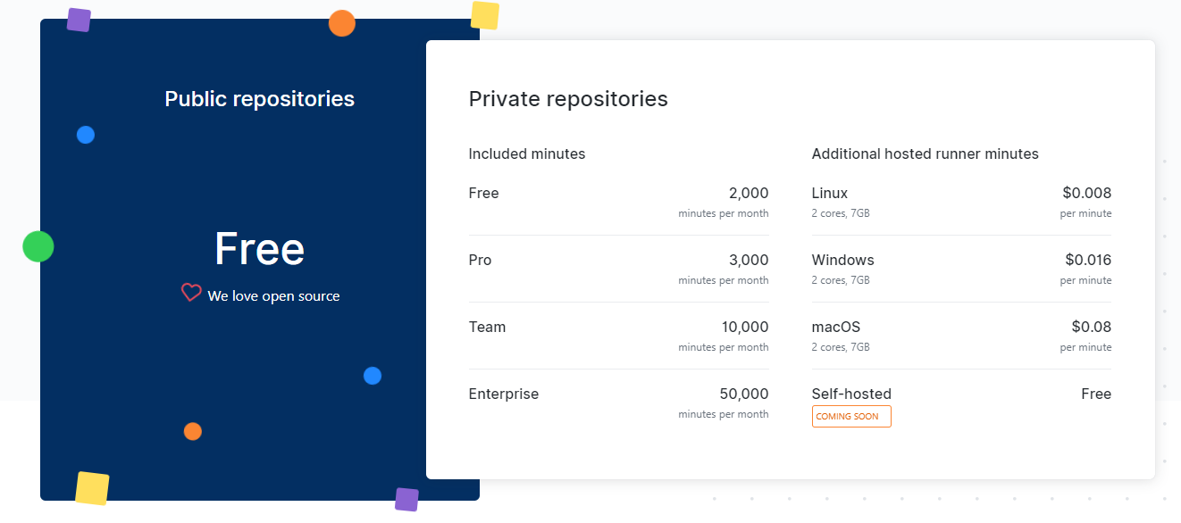
Simple, pay-as-you-go pricing

Slide 9
Demo: Your first Workflow
Notes:
Add a workflow to a hello world node app
When triggered

Slide 10
A Sample Workflow
on:
push:
branches:
- master
jobs:
build-and-deploy:
name: Build and Deploy
runs-on: ${{ matrix.os }}
strategy:
matrix:
node_version: ['8', '10', '12']
os: [ubuntu-latest, windows-latest, macOS-latest]
steps:
- uses: actions/checkout@v2
- name: Use Node.js ${{ env.NODE_VERSION }}
uses: actions/setup-node@v1
with:
node-version: ${{ env.NODE_VERSION }}
- name: npm install, build, and test
run: |
npm install
npm run build --if-present
npm run test --if-present
What event triggers the workflow?
Where does it run?
What gets run?
Notes:
Not limited to Git operations, also webhooks, basically anything on GitHub

Slide 11
How do I write my own Custom Action?

Slide 12
Why might you want a custom action?
Control over logical flow
Use of custom tools not present on the agent
Aid management of complexity
Code reuse
Notes:
Control over logical flow
Wrapper loads of command
Use of custom tools not present on the agent
Avoid the need to install something, or use a language not present
Aid management of complexity
Related to both of the about
Code reuse
Avoids need to cut and past blocl

Slide 13
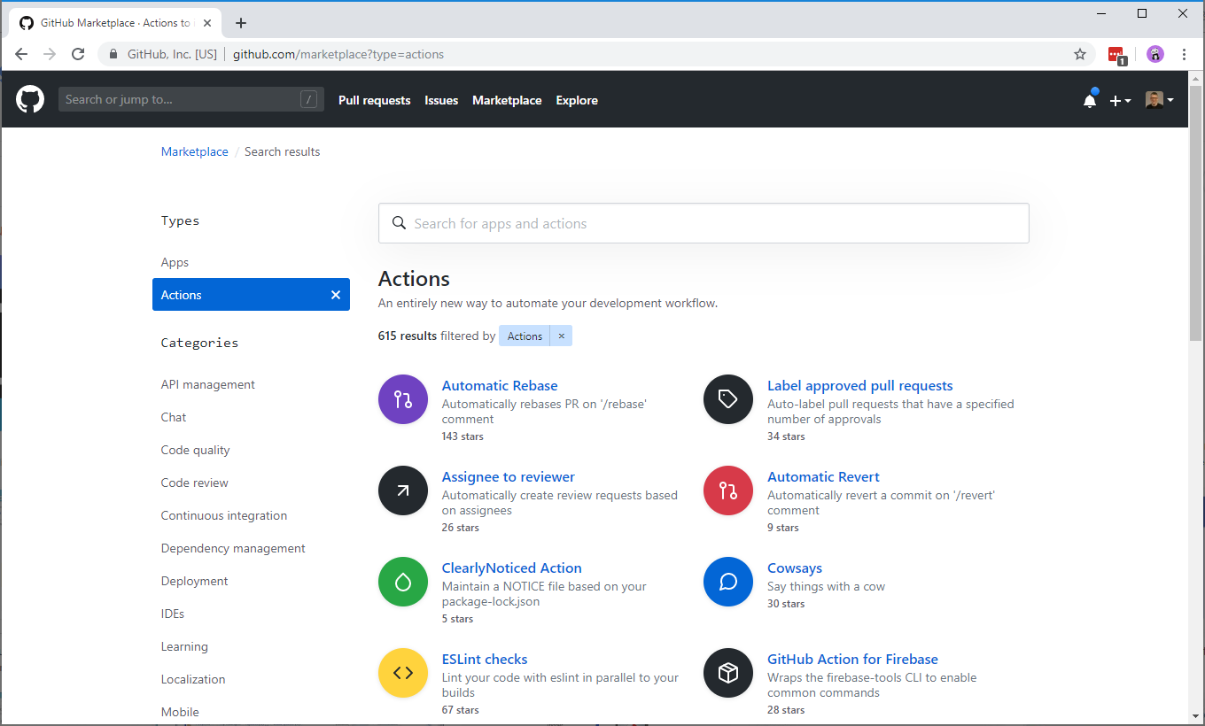
Before you start, remember the Marketplace

Slide 14


What do I write my action in?
JavaScript
Docker
Fast to load
Runs directly on Agent
SDK for Workflows API
Templates available
But requires correct setup
Flexible, any tools any language
Built at runtime or loaded from Docker Registry
Consistent results
Slower to start

Slide 15
Anatomy of an Action.yaml file
name: 'Apply Version to JSON file'
description: 'Adds a version number to a field in a JSON file'
author: 'Richard Fennell'
inputs:
Path:
description: 'Source folder Filter (folder under GITHUB_WORKSPACE)'
default: ''
required: false
VersionNumber:
description: 'Version Number'
default: ''
required: true
outputs:
FileUpdated:
description: 'The name of the file updated'
runs:
using: 'node12'
main: 'lib/main.js'
branding:
icon: 'file-text'
color: 'green'
runs:
using: ’docker'
main: ’docker://image:tag'
runs:
using: ’docker'
main: ’dockerfile'
Notes:
A metadata file called either action.yml or action.yaml that defines
The inputs
The outputs
Main entrypoint for your action.

Slide 16
But I have some custom Azure DevOps Pipeline Tasks. Can I reuse them?

Slide 17
What is a good candidate?
Should be written in Node.JS
Can’t make use of Azure DevOps specific APIs
Must do something that is useful in GitHub workflows
Notes:
Of course you can port other languages
Docker opens up interesting opportunities

Slide 18
How did I write my own Custom Action?
Create a new repo from the template generator
https://github.com/actions/typescript-action
Copied in my task code into the repo bit by bit
Removed any Azure DevOps specific code that was not needed
Swapped the references to “vsts-task-lib/task” to “@actions/core”
Swapped tests from Mocha/Chai to Jest
Added running of TSLint to the build process
Updated the action manifest to expose parameters
Notes:
Create a new repo from https://github.com/actions/typescript-action
Copied in my task code into the repo bit by bit
Renamed my entry ApplyVersionToJSONFile.ts file to main.ts to keep inline with the template standard
Copied over the AppyVersionToJSONFuncitons.js
I removed any Azure DevOps specific code that was not needed.
In both files swapped the references to “vsts-task-lib/task” to “@actions/core” and update the related function calls to use
core.getInput()
core.debug()
core.warning()
core.SetFailed()

Slide 19
Adding a Release Branch
# comment out in distribution branches
# node_modules/
$ git checkout -b releases/v1
$ npm prune --production
$ git add node_modules
$ git commit -a -m "prod dependencies"
$ git push origin releases/v1
Notes:
As the scripts run from the repo needs the dependencies
This is a difference from Azure DevOps

Slide 20
Versioning your Action Updates
branch: master
master
fix issue from testing
fix bug
merge or rebase
branch: releases/v1
create release + tag: 1.0.1 tag: v1
merge or rebase
create release + tag: 1.0.2 move tag: v1
releases/v1
Check-in prod dependencies Test E2E
test E2E referencing releases/v1 branch ‘latest’ unreleased
Based on https://github.com/actions/toolkit/blob/master/docs/action-versioning.md

Slide 21
How to use your action in a workflow?
steps:
- uses: ./ # Uses a private action in the root directory of workflow repo
- uses: rfennell/JSONFileVersioner@74bc508 # a specific commit of a public action
- uses: rfennell/JSONFileVersioner@master # a branch of a public action
- uses: rfennell/JSONFileVersioner@v1.0.1 # the version of a release of a public action
- uses: rfennell/JSONFileVersioner@v1 # the major version of a release of a public action

Slide 22
Finally add it to the GitHub Marketplace
In your GitHub repo create a new draft release
Select ‘Publish to Marketplace’
Fix any errors, usually by checking in or editing files
Choose categories
Pick the tag that points to version to release
Click Publish release

Slide 23
Demo: A look at a Custom Action

Slide 24
Summary
GitHub Actions are a new alternative for CI/CD
You now don’t have to leave GitHub or provision other resources
They are free for OSS and pay-per-minute for private repo
They are not as rich in features as Azure DevOps Pipelines, yet…
Also, remember they are not limited to CI/CD
They can trigger a workflow on any GitHub event

Slide 25
Resources
There is an active community
https://github.community/t5/GitHub-Actions/bd-p/actions
And documentation at
https://help.github.com/en/categories/automating-your-workflow-with-github-actions
And a Pluralsight Course
‘Building Custom GitHub Actions’ By Enrico Campidoglio

